Slide 1
Financing a Software Infrastructure for Highly Parallelized Codes
2011
Earl Joseph – ejoseph@idc.com
Steve Conway – sconway@idc.com
Gabriella Cattaneo – gcattaneo@idc.com

Slide 2
IDC HPC Market Update:
Top Trends in HPC
The global economy in HPC is growing again
  2010 grew by 10%, to reach $9.5 billion
  We are forecasting ~7% growth over the next 5 years
Major challenges for datacenters
  Power, cooling, real estate, system management
  Storage and data management continue to grow in importance
Software hurdles will rise to the top for most users
SSDs will gain momentum and could redefine storage
GPUs are seeing real tractions in certain verticals
The worldwide Race on Petascale is in full speed

Slide 3
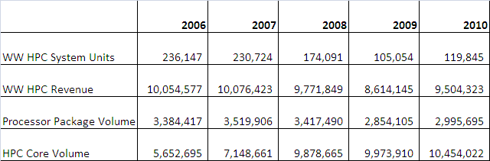
IDC HPC Market Update:
HPC WW Market Results

Slide 4
HPC Vendor Revenue Shares, 2010

Slide 5
Revenue Share by Vendor
Supercomputer Segment
Notes:
Could make each a separete chart

Slide 6
Industry/Application Segments
HPC Server Revenue by Application/Industry
 | 2009 | 2010 | Growth
Bio-Sciences | 1,171 | 1,294 | 10.4%
CAE | 913 | 1,060 | 16.1%
Chemical Eng | 187 | 203 | 8.6%
DCC & Distribution | 478 | 549 | 15.0%
Economics/Fin | 205 | 266 | 30.1%
EDA/IT/ISV | 559 | 629 | 12.5%
Geosciences | 564 | 605 | 7.2%
Mechanical Design | 75 | 80 | 6.5%
Defense | 894 | 951 | 6.3%
Government Lab | 1,418 | 1,520 | 7.2%
University | 1,721 | 1,832 | 6.4%
Weather | 371 | 412 | 11.0%
Other | 80 | 104 | 29.2%
Total Revenue | 8,637 | 9,504 | 10.0%
Source: IDC 2011

Slide 7
HPC Market
Forecasts

Slide 8
2011 Buyer Driving Factors

Slide 9
2011 Buyer Driving Factors

Slide 10
HPC Server Revenue ($M) Forecast
 | 2010 | 2011 | 2012 | 2013 | 2014 | 2015 | CAGR
HPC Revenues | 9,504 | 10,034 | 10,564 | 11,397 | 12,371 | 13,449 | 7.2%
System Units | 119,845 | 133,044 | 146,243 | 165,391 | 172,306 | 179,515 | 8.4%
Source: IDC 2011

Slide 11
The Broader HPC Market
 | 2009 | 2010
Servers | 8,637,114 | 9,504,323
Storage | 3,022,990 | 3,328,312
Middleware | 1,062,365 | 1,103,797
Applications | 2,971,167 | 3,164,293
Service | 1,658,326 | 1,727,976
Total | 17,351,963 | 18,828,701

Slide 12
Conclusions
2010 was a year of return to healthy growth in the worldwide HPC market
IDC predicts the HPC market will continue growth in 2011 and grow by 7% to 9% in 2011
  And then will rebuild to reach $13.5 billion by 2015
The recovery will benefit HPC segments unevenly:
  With hard-hit verticals such as automotive recovering more slowly than oil and gas, or government and academia
  The Supercomputer segment growth will remain turbo-charged by government spending aimed at HPC leadership and “petaflop club” membership
    And could exceed our current forecasts

Slide 13
But There are Still Major Customer Pain Points
Software is still the #1 roadblock
  Better management software is needed
    HPC clusters are still hard to setup and operate
    New buyers – require “ease-of-everything”
  Parallel software is lacking for most users
    Many applications will need a major redesign
    Multi-core will cause many issues to “hit-the-wall”
Clusters are still hard to use and manage
  System management & growing cluster complexity
  Power, cooling and floor space are major issues
  Third party software costs
  Weak interconnect performance at all levels
  RAS is a growing issue
  Storage and data management are becoming new bottle necks
  Lack of support for heterogeneous environment and accelerators
Notes:
Multi-core issue: hard to use(apps don’t scale well (or no apps at all) to take advantage of the processing capability), memory bandwidth limit,

Slide 14
Study Results:
Financing a Software Infrastructure for Highly Parallelized Codes

Slide 15
Goals for the Study
Map the parallel codes landscape in Europe
Set the framework for creating a European software infrastructure for research and science
Analyze the strengths and weaknesses of the infrastructure
Point out the opportunities arising from the infrastructure
Identify the appropriate management structure and governance model for the infrastructure

Slide 16
Information Sources
New field research conducted for this study
  Broad end-user surveys
  In-depth interviews with key officials
IDC worldwide research on HPC application software, servers, end-user issues, etc.
Documents/information from other organizations pursuing software advances in Europe:
  IESP, EESI
  ISVs (Dassault Systems, Siemens, et al.)

Slide 17
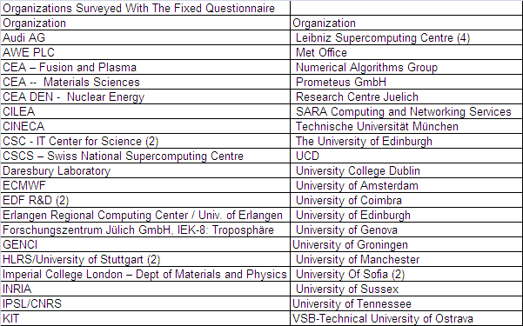
Survey Overview
53 (47 standard surveys representing 79 major codes, 6 in-depth interviews)

Slide 18
Key Findings
Europe has a number of globally successful scientific and engineering software firms, a larger number of nationally and regionally successful software firms, and is strong in many important areas of parallel software development
The underlying problem is that modern HPC hardware with large numbers of CPU cores, each with decreasing levels of memory and memory bandwidth, is causing a mismatch with existing application software, driving a need to fundamentally redesign and rewrite HPC application software for greater parallelism, in order to perform well on future HPC systems

Slide 19
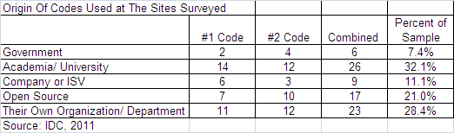
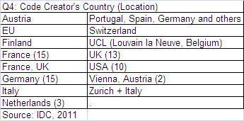
Survey Overview: Origin Of The Codes

Slide 20
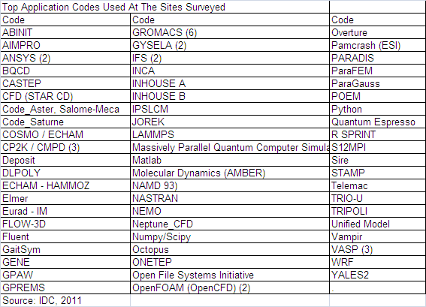
Top Application Codes Used at Survey Sites (79 Codes at 47 Sites)

Slide 21
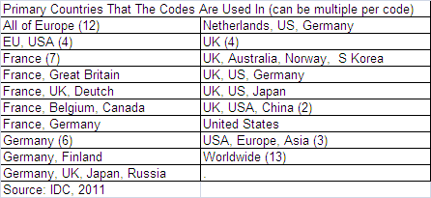
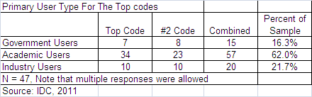
Survey Results: Code Users

Slide 22
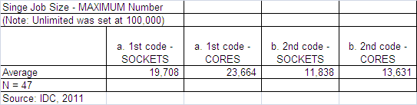
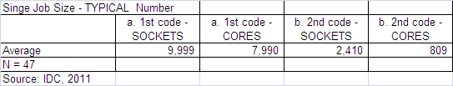
Survey Results: Current Scaling Levels

Slide 23
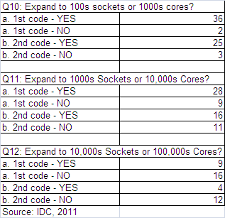
Survey Results: Scaling Knowledge
Most know how to grow to 100’s, 1,000’s and even 10,000, but not 100,000

Slide 24
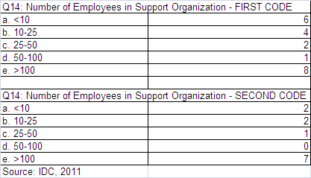
Survey Results: Support Organization Size

Slide 25
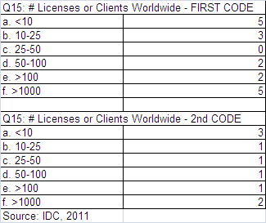
Survey Results: Licenses In Place
Each code has only a few users

Slide 26
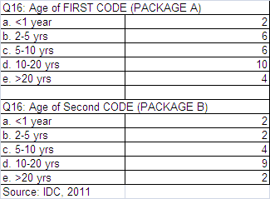
Survey Results: Average Age Of Codes
Most are designed around 10-20 year old architectures

Slide 27
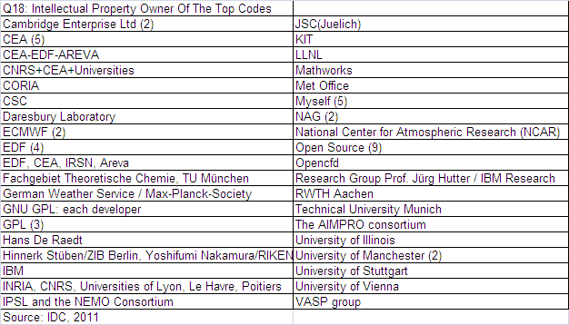
Survey Results: IP Owners

Slide 28
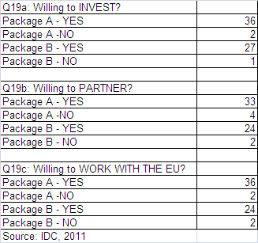
Survey Results: Willingness To Improve Codes

Slide 29
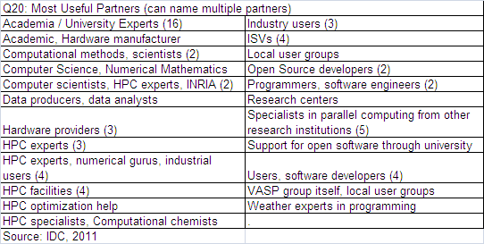
Survey Results: Desired Partners

Slide 30
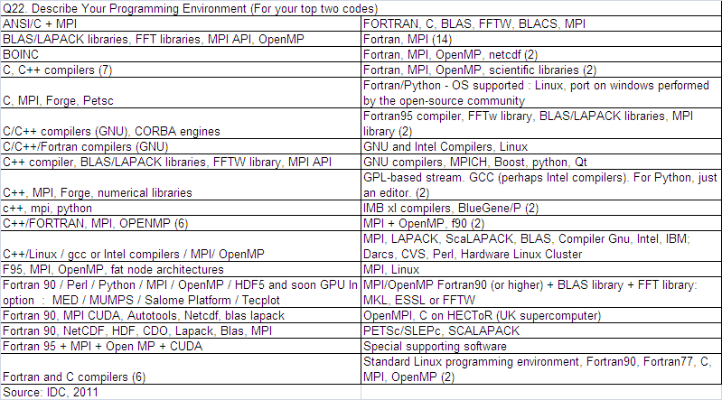
Survey Results: Programming Environments Used

Slide 31
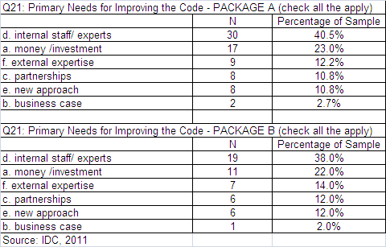
Survey Results: What Is Needed The Most

Slide 32
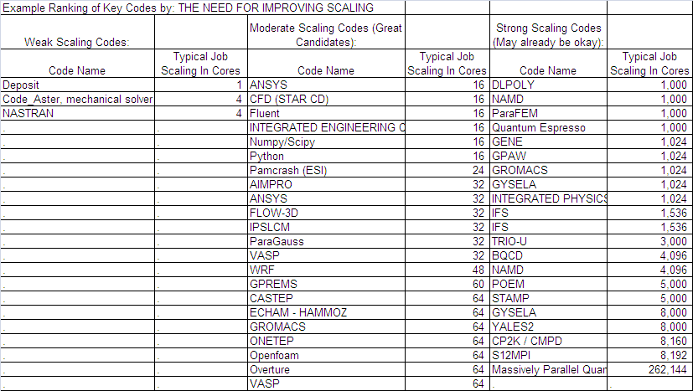
Application Rankings By The Need For Better Scaling

Slide 33
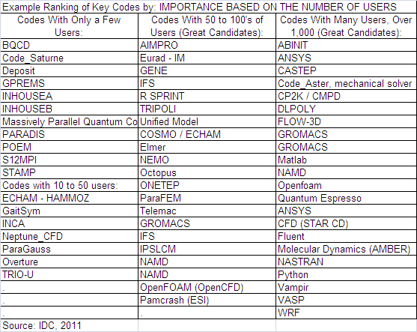
Application Rankings By Importance

Slide 34
Recommendations

Slide 35
First, Implement The Key Strategies From Last Year’s Recommendations
First is the need for expanding the number and size of HPC resources across the EU (including broader access to the tools by all EU researchers)
Second is to provide broader access to industrial HPC users
Third is to make HPC users more productive by creating the world's best tools, training and development environment
  Requires a new initiative (HPC development labs/test-beds)
Fourth is to attract more students into scientific, engineering and HPC fields and to attract more experts around the world to join in EU projects.
  Requires additional funding and a "Magnet" program
Fifth is the need to increase funding in developing next generation Exascale software
Sixth is to target a few strategic application areas for global leadership

Slide 36
First, Implement The Key Strategies From Last Year’s Recommendations

Slide 37
Recommendations:
Key Actions Required

Slide 38
Key Actions Required
Use HPC Parallel Software Development to Help Close Europe's Innovation Gap
  Europe has a limited window-of-opportunity to become a global innovation leader in targeted domains of scientific and engineering research
Establish an e-Infrastructure for Advancing Parallel Software:
  Create a new EC body to coordinate the holistic parallel software and holistic HPC strategy for Europe
  Establish European centers-of-excellence for parallel software development
  Create a European Web-based parallel software clearinghouse
  Establish "Tiger Teams" to improve HPC access across Europe
  Put into place the recommended parallel software funding

Slide 39

Europe’s Economic Growth Is Threatened By An Innovation Gap
"…research and innovation are key strands of the Europe 2020 strategy.
Stark figures confront this ambition to use knowledge as a driver for sustainable growth. Albeit with large internal variations, Europe consistently spends less than 2 per cent of GDP on research and development, only two-thirds of that in the US and a little more than half the Japanese figure. Meanwhile, China's investment is growing year by year and will be on a par with Europe in a few years. The EU Innovation Union Scoreboard tells a similar story: a big innovation gap with Japan and the US, with China (not to mention India and Brazil) quickly catching up."
Robert-Jan Smits, Director General for Research and Innovation of the European Commission

Slide 40
HPC Is a Proven Tool for Accelerating Innovation
HPC has become established as the third branch of the scientific method
In one worldwide IDC study, 97% of companies that had adopted HPC said they can’t compete or survive without it
Political leaders increasingly recognize HPC’s crucial role for driving innovation and competitiveness:
  U.S. Presidents George W. Bush, Barack Obama
  Russian President Dmitry Medvedev
  Rep. Chung Doo-un, S. Korea
PRACE and other HPC programs in Europe

Slide 41
Europe Is Positioned To Pursue Global Leadership In Domains Where Europe Is Strong
Weather and climate research
Clean and sustainable energy
Automotive and aerospace design
Bio-life sciences
Particle physics and related fields
Materials science/molecular dynamics

Slide 42
Parallel Software Development Is The Key To HPC Leadership
The goal is not HPC leadership but leadership in scientific and engineering innovation
Leadership will be determined far more by software advances than by hardware progress
  Europe and the rest of the world have focused too heavily on parallel hardware, to the detriment of parallel software
  Parallel software advances are needed to maximize the returns on hardware investments

Slide 43
Key Actions Required
Use HPC Parallel Software Development to Help Close Europe's Innovation Gap
  Europe has a limited window-of-opportunity to become a global innovation leader in targeted domains of scientific and engineering research
Establish an e-Infrastructure for Advancing Parallel Software:
  Create a new EC body to coordinate the holistic parallel software and holistic HPC strategy for Europe
  Establish European centers-of-excellence for parallel software development
  Create a European Web-based parallel software clearinghouse
  Establish "Tiger Teams" to improve HPC access across Europe
  Put into place the recommended parallel software funding

Slide 44
Create a Governing Body
The EC should create a new body to coordinate European R&D initiatives for the HPC ecosystem
  Including parallel software, hardware, networking, etc.
  To ensure R&D is consistent, integrated, efficient
  This would not affect Member States’ autonomy over their national HPC strategies
  Coordination does not mean sole decision-marking authority
The EC should convene a 2-3 day meeting of the interested parties to discuss this
  Capture all perspectives, suggestions
  Begin to plan

Slide 45
Key Actions Required
Use HPC Parallel Software Development to Help Close Europe's Innovation Gap
  Europe has a limited window-of-opportunity to become a global innovation leader in targeted domains of scientific and engineering research
Establish an e-Infrastructure for Advancing Parallel Software:
  Create a new EC body to coordinate the holistic parallel software and holistic HPC strategy for Europe
  Establish European centers-of-excellence for parallel software development
  Create a European Web-based parallel software clearinghouse
  Establish "Tiger Teams" to improve HPC access across Europe
  Put into place the recommended parallel software funding

Slide 46
Establish Centers-of-Excellence for Parallel Software Development
To help unify Europe’s scientific and engineering research communities – by domain
  Each center would have primary responsibility for parallel software develop in its domain (planning, funding recommendations, etc.)
  The centers would be hosted by large or medium-size HPC centers with strengths in the domain in question.
  Some domains would be assigned to multiple centers, to exploit their specific strengths
  The targeted domains (again) are weather and climate, automotive, aerospace, energy, bio-life sciences, particle physics and related fields, and materials science/nanotechnology

Slide 47
Key Actions Required
Use HPC Parallel Software Development to Help Close Europe's Innovation Gap
  Europe has a limited window-of-opportunity to become a global innovation leader in targeted domains of scientific and engineering research
Establish an e-Infrastructure for Advancing Parallel Software:
  Create a new EC body to coordinate the holistic parallel software and holistic HPC strategy for Europe
  Establish European centers-of-excellence for parallel software development
  Create a European Web-based parallel software clearinghouse
  Establish "Tiger Teams" to improve HPC access across Europe
  Put into place the recommended parallel software funding

Slide 48
Create a European Parallel Software Clearinghouse
A single, Web-based organization serving Europe
  To serve large organizations as well as SMEs and SMSs
Proposed services:
A simple, easy way to get to software codes – well explained and documented
A store front for new and existing parallel software
Negotiate contracts for ISV software, with price no higher than buying directly from ISVs
Free access to open source and community parallel software
Pay-as-you-go (SaaS) access to ISV software
Sponsored and pay-as-you-go (IaaS) access to hardware systems and expertise in using them
Expert decision-support systems to help clients make choices
A place to buy/sell software IP
Obtain services and training
Venture capitalists can “shop” for software startups to invest in

Slide 49
Key Actions Required
Use HPC Parallel Software Development to Help Close Europe's Innovation Gap
  Europe has a limited window-of-opportunity to become a global innovation leader in targeted domains of scientific and engineering research
Establish an e-Infrastructure for Advancing Parallel Software:
  Create a new EC body to coordinate the holistic parallel software and holistic HPC strategy for Europe
  Establish European centers-of-excellence for parallel software development
  Create a European Web-based parallel software clearinghouse
  Establish "Tiger Teams" to improve HPC access across Europe
  Put into place the recommended parallel software funding

Slide 50
Establish “Tiger Teams”: To Improve HPC Software Across Europe
Typically two-persons (domain expert + parallel programmer expert)
  Paid assignments for experts (along with an extended team of domain experts)
  Prestige assignments – working on behalf of Europe and the Member States
Visit sites (3-5 days) for the following purposes:
  Assess needs for parallel software use and improvements (review each of their key codes)
  Complete “easy” improvements on site and setup a solution to address the harder ones, e.g. the centers-of-excellence
  Create an action plan for the client organizations
  Return later, if appropriate, to provide further help

Slide 51
Key Actions Required
Use HPC Parallel Software Development to Help Close Europe's Innovation Gap
  Europe has a limited window-of-opportunity to become a global innovation leader in targeted domains of scientific and engineering research
Establish an e-Infrastructure for Advancing Parallel Software:
  Create a new EC body to coordinate the holistic parallel software and holistic HPC strategy for Europe
  Establish European centers-of-excellence for parallel software development
  Create a European Web-based parallel software clearinghouse
  Establish "Tiger Teams" to improve HPC access across Europe
  Put into place the recommended parallel software funding

Slide 52
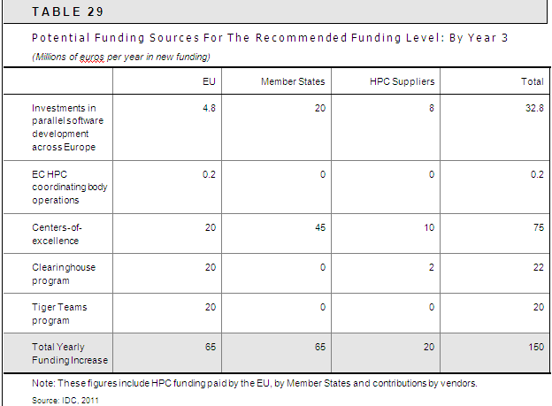
Recommended Funding

Slide 53
Actions Needed by the European Commission
Determine the receptivity within the Commission to establishing the European parallel software e-infrastructure, including a new body to coordinate the European HPC strategy, including the parallel software e-infrastructure
Prevent the EESI participants from disbanding after they submit their final report in fall 2011
Convene a 2-3 day meeting, to take place by December 2011, where the interested parties will discuss the findings and recommendations of this study and begin organizing the parallel software e-infrastructure program, as recommended

Slide 54
Actions Needed by the European Commission
Establish the European HPC/parallel software coordinating body
Establish the domain-specific, European centers-of-excellence for parallel software development
Establish the web-based clearinghouse program for parallel software and related HPC resources and services
Establish the Tiger Teams program and recruit the first (10-20) tiger teams
Fully fund the recommendations

Slide 55
Actions Needed by the Member States
Provide the level of support for the recommended European parallel software e-infrastructure, including the recommended new coordinating body within the European Commission and the other elements of the initiative
Participate in the 2-3 day meeting the European Commission will convene by December 2011
Fully fund the recommendations

Slide 56
In Conclusion:
Potential Risks If No Action Is Taken
Another Region or Nation Could Seize This Opportunity and Further Widen Europe's Innovation Gap
Europe Could Become Inferior To The U.S. and Asia in Scientific and Engineering Research
Europe and The EU Member States Could Lose Industrial Competitiveness and Jobs
Europe and The EU Member States Could Experience An Escalating Brain Drain To The U.S. And Asia, Along With Greater Difficulty In Attracting Talented Scientists And Engineers

Slide 57
In Conclusion:
The Main Direction Required
Good Exascale hardware is required but …
The main need TODAY is for better software:
  In all areas – applications, middleware, compilers, I/O, etc.
  Better highly parallel software will provide the greatest performance increases to applications
    Due to the ever growing disconnect between the RAW hardware capability and our ability to have software that can make use of the power

Slide 58
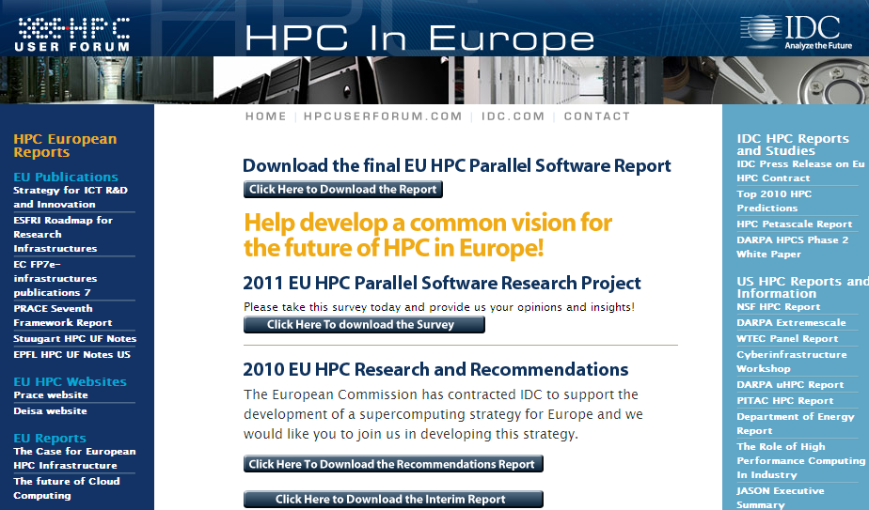
For A Copy Of The Report: www.hpcuserforum.com/EU/

Slide 59

Questions?
Please email:
hpc@idc.com
Or check out:
www.hpcuserforum.com

Slide 60
Questions?
Please email:
hpc@idc.com
Or check out:
www.hpcuserforum.com

Slide 61
In Conclusion:
Potential Risks If No Action Is Taken
Europe and The Member States Could Become Increasingly Reliant On The U.S. and Asia For Scientific, Industrial, and Technological Advances
The Smaller and Less Affluent EU Member States Could Lose The Ability To Access and Benefit From Large HPC Systems. This Could Widen The Digital Divide In Europe, To The Detriment Of The Smaller Countries
Europe's Existing Strengths in Hardware, Software and Other HPC-Related Technologies Could Diminish or Disappear From Lack Of Advancement

Slide 62
Survey Key Findings
The majority (83%) of the most important parallel software applications in use at the surveyed European HPC sites were created in Europe
Intellectual property rights for a substantial majority of the sites' most important application codes (66%) were exclusively owned by European organizations
Study participants responded that parallel software development for scientific and industrial/commercial use is important enough to establish a coordinating body within the European Commission

Slide 63
Survey Key Findings
Only a few of the site's single most important application codes scale beyond 1,000-2,000 processor cores today
  77% of the sites thought they could exploit tens of thousands of cores
  36% said they believed they could scale to hundreds of thousands of cores
Half of the sites' first top codes were 10 or more years old, and 14% were more than 20 years old
  Although most (71%) of the first top codes have undergone a technical update within the past year
  And nearly all (97%) have been updated within the past five years

Slide 64
Survey Key Findings
Nearly all of the surveyed sites said they would be willing to invest in improving the parallel software application codes
  The key missing ingredients for improving the sites' important parallel codes are adequate internal expertise and financial investment
Respondents associated with industrial/commercial HPC use stressed that the development models for scientific and industrial/commercial parallel software need to be different
  They said industrial/commercial representatives need to be involved in developing/advancing codes intended for their use, and that they would be willing to contribute

Slide 65
Scientific Software Development Model
Scientific Software Development Model
Industrial Software Development Model
Target areas where Europe can lead
Academic experts create roadmap
RFPs based on roadmap
Peer review decides who gets funded
5-10 year renewal eligibility
Academic experts recommend renewals
100% funded by EC
Target areas where Europe can lead
Academic-industry experts create goals, timeline
RFPs based on goals, timeline
Academic-industry experts determine winners
Fixed-cost, fixed-date contracts (focused on clear single project deliverables)
Proportion funded by EC varies by contract & IP terms

